Slide 1
CMPS 254
File System
Programming

Slide 2
OBJECTIVES
File Descriptor
System calls used in file systems

Slide 3
File Descriptor - fd
Each file entry in every directory contain
information describing the file:
File name
File type
File size
File location
Date and time of creation.
Owner.
Protection information
Record size
Notes:
The file descriptor is a per-process object. The same descriptor number in two different processes may refer to different files. When the user for example calls open , the kernel uses the file descriptor to quickly locate the open file object and other data structures associated with the open file. Each file descriptor represents an independent session with the file. The associated open file object holds the context for that session. This includes the mode the file was opened and the offset pointer at which the next read or write must start.
Unix processes use the file descriptor as the main file identifier. A process may duplicate a descriptor through dup or dup2 system calls. These calls create a new descriptor that references the same open file object. Users see this when they use shell constructs like 2>&1 to redirect the standard error to the standard output.
Reference: Silberstchatz Galvin Gagne, Operating Systems concepts

Slide 4
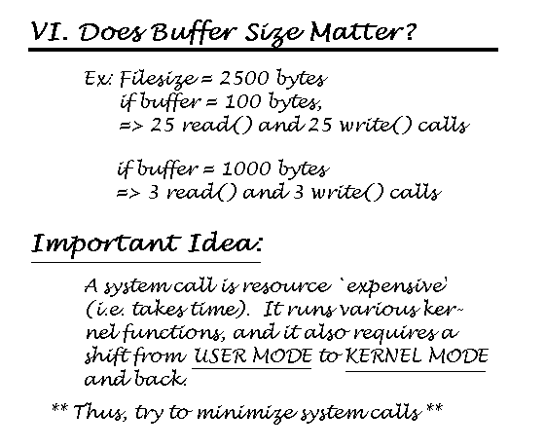
System calls and Buffer Size

Slide 5
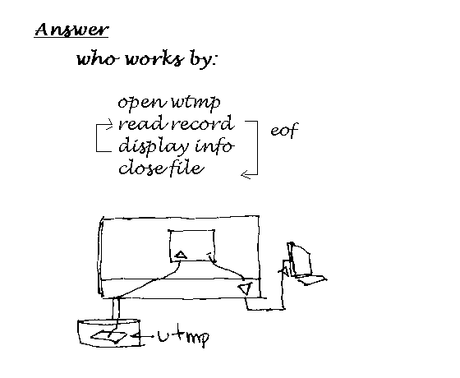
System Calls

Slide 6
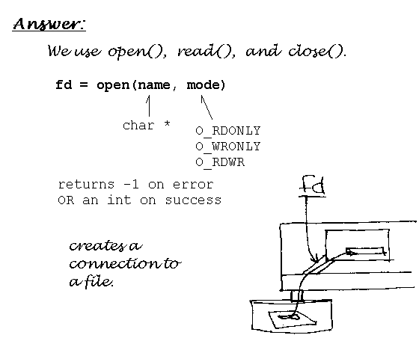
Open ( )

Slide 7
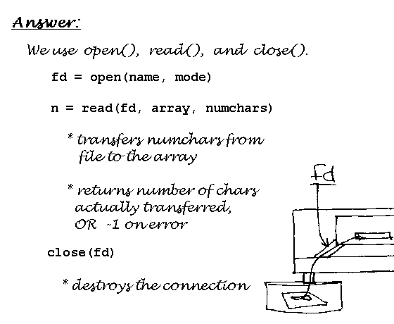
Open( ), Read( ) and Close( )

Slide 8
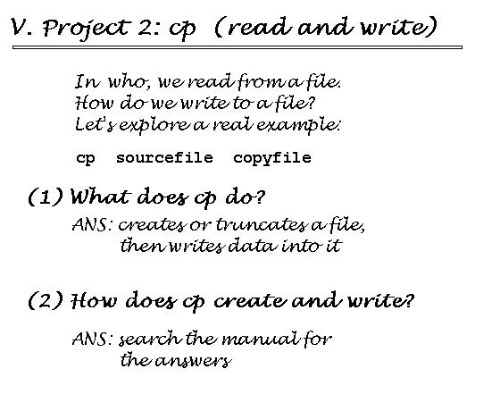
Read ( ) and Write( ) system calls

Slide 9
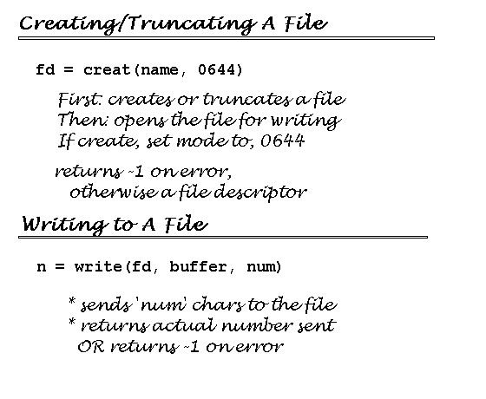
Creat( ) system call

Slide 10
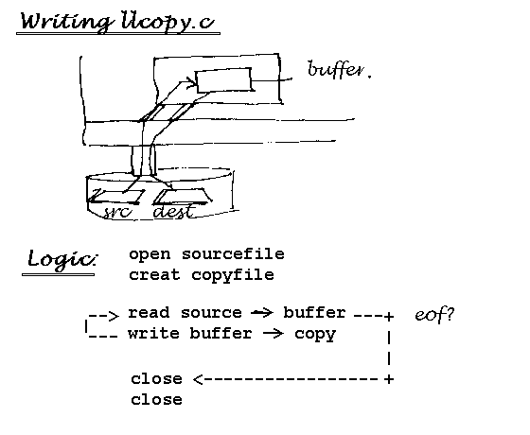
Open ( ) and creat( ) system calls

Slide 11
References
Bruce Molay, Understanding Unix/Linux Programming, Prentice
Hall.

